Slide 1





This project has received funding from the Horizon Europe research and innovation programme under the Marie Skłodowska-Curie Grant Agreement No. 101119635
This project has received funding from the Horizon Europe research and innovation programme under the Marie Skłodowska-Curie Grant Agreement No. 101119635

Slide 2
Reinforcement Learning based Recommender System for investments
Mohamed Faid
Ismail Elbouknify

Slide 3
Table of contents
3
Motivation
Problem Definition
Dataset
Markov Decision Process
Heuristics and Evaluation
Q Learning and Limitations
DQL and Limitations
Challenges and Future work

Slide 4
Motivation
4
Complexity and dynamic nature of financial markets require advanced analytical tools.
The trade-off between investment profitability and adherence to individual investor preferences is often overlooked.
From a market maker such as banks knowing the potential costumer profile.( RQ2)

Slide 5
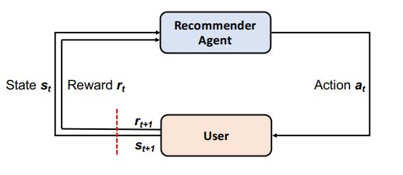
Problem Definition
5
Develop a recommendation system that suggests financial assets tailored to each customer's profile (risk appetite, preferences etc..)
How to recommend financial assets tailored to the customer profile ? .

Slide 6
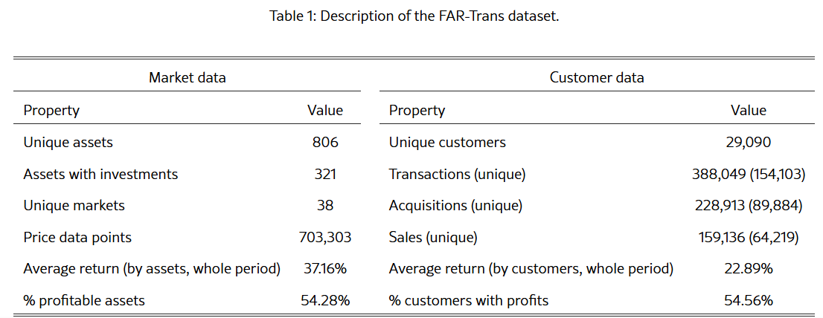
Dataset
6

Slide 7
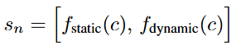
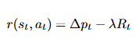
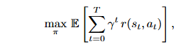
Markov decision process
7
We model the financial asset recommendation task as a Markov Decision Process (MDP) defined by the tuple (S, A, P, R, γ)
State (S): A vector combining static customer information and dynamic transaction data.
Action (A): An action a ∈ A corresponds to recommending a financial asset.
Transition Probability (P): We assume independent events, the transition probability represent the probability that the user will accept the recommendation.
Reward (R): Based on change in asset prices and client portfolio:
Objective: The goal is to learn a policy π : S → A that maximizes the expected cumulative discounted reward:

Slide 8
Real Dataset for Model validation
8
Data Source: Utilizes the FAR-Trans dataset, capturing market activity available to Greek investors between January 2018 and November 2022
Contents of the Dataset:
Customer Profiles: Static attributes such as risk tolerance, customer type, and investment capacity.
Asset Information: Detailed data on various financial assets.
Market Data: Pricing time series and broader market indicators.
Historical Transactions: Records of past investment actions.

Slide 9
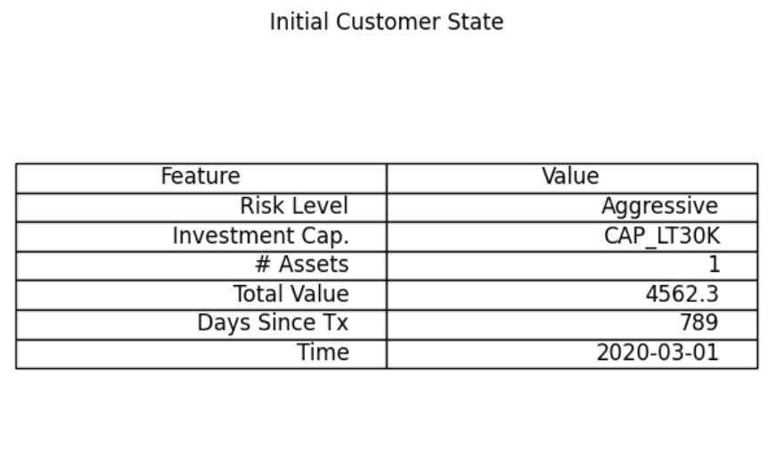
Markov decision process
9
Example of a state representation.

Slide 10
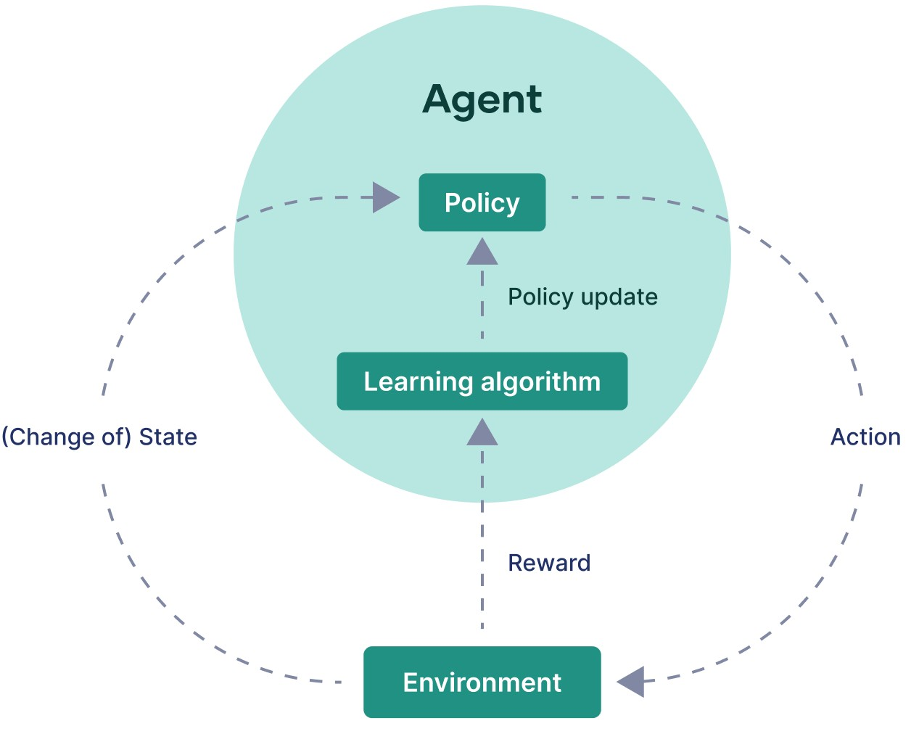
Markov decision process
10
Fully Observable (MDP): The agent has complete information about the current state. We assume that the composition of the portfolio is know at every state.
Discrete environment: Limited set of states/actions
Single-Agent: One decision-maker interacts with the environment.

Slide 11
Heuristics and Evaluation
11
Profitability-based models: Forecasting
Transaction-based models: Popularity based - Collaborative filtering
Hybrid methods
Metrics : ROI@k and nDCG@k (how close the recommendations are to the investments made by customers in the (t, t + ∆t) )

Slide 12
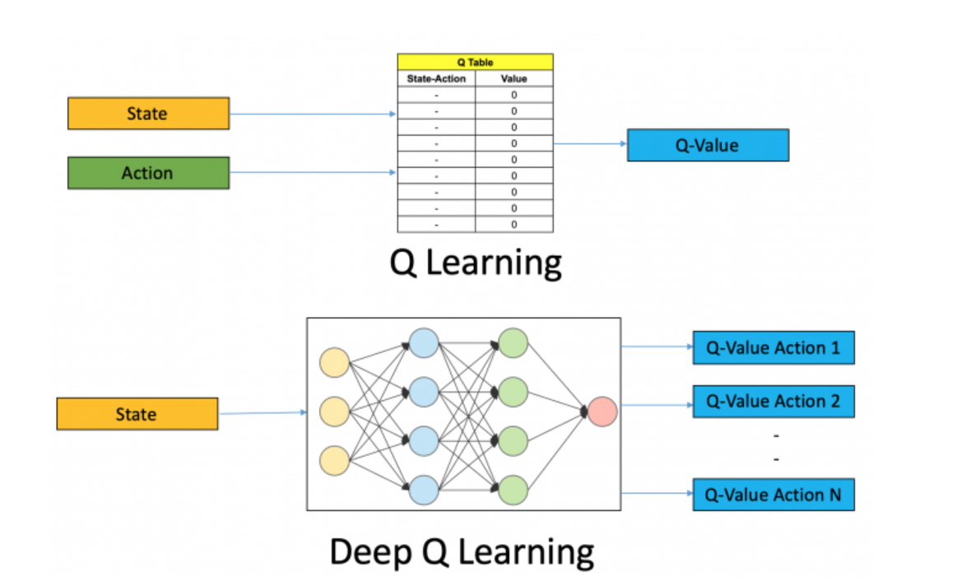
DQL and Limitations
12
Stores Q-values in a table: (state, action) → value
Doesn’t scale with large or continuous state spaces
Memory + lookup cost explodes as state/action space grows
DQL ≈ Q-learning + Neural Networks → Scalable decision-making.

Slide 13
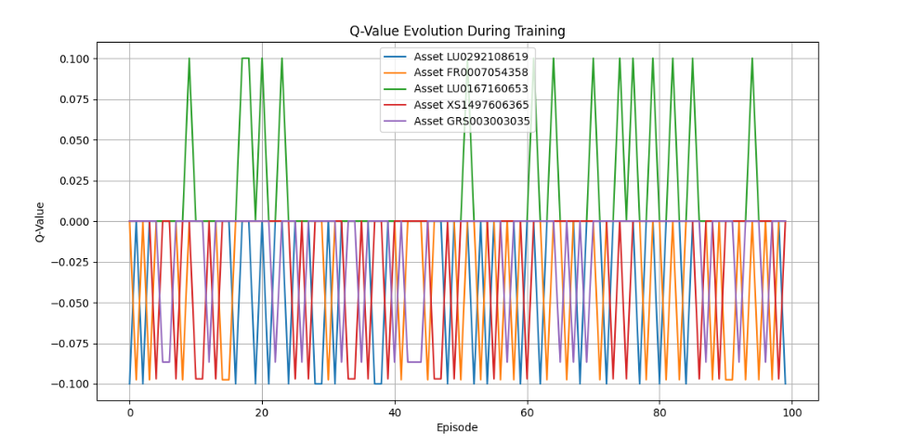
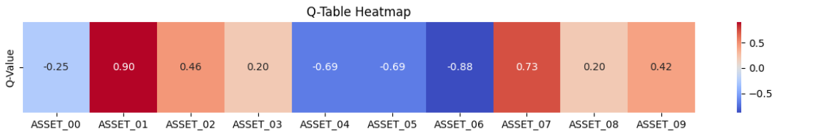
Q-Learning and Limitations
13
The Q-learning is able to recommend the asset that matches the customer risk to the asset risk
Not suitable for high dimensions which the very limitation to be able to recommend a wide range of assets

Slide 14
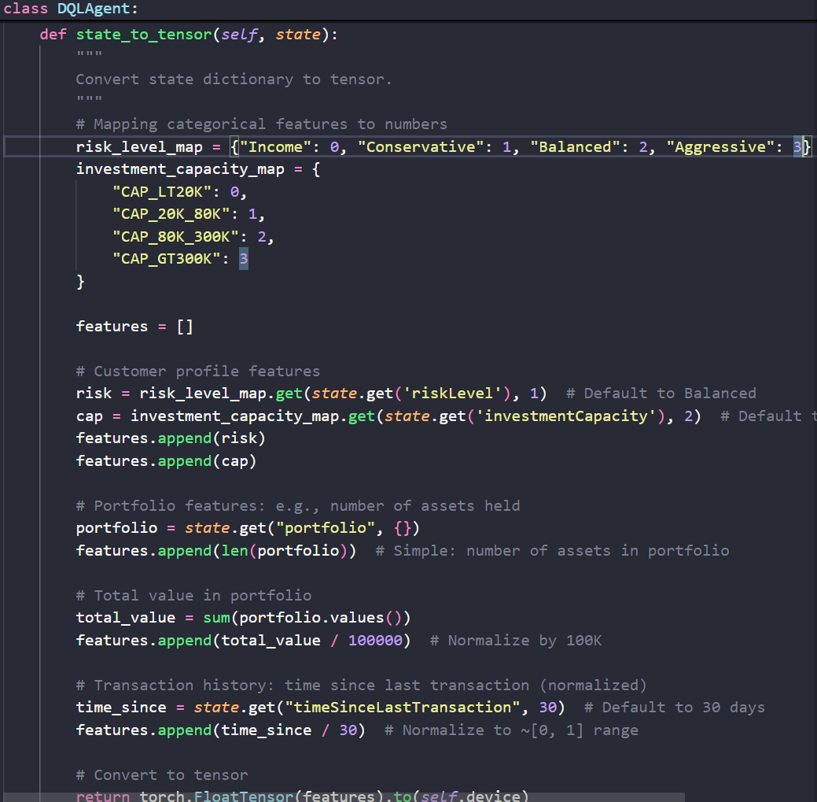
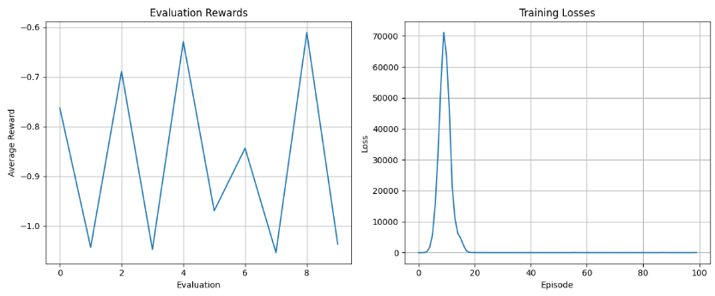
DQL and Limitations
14
Loss Converge after a weird spike
Reward formulation has a lot of limitation
Improve tensor representation of states

Slide 15
15
2/24/2025

Slide 16
Problem Definition
16
Develop a recommendation system that suggests financial assets tailored to each customer's profile (risk appetite, preferences etc..)
RQ : How to recommend financial assets tailored to the customer profile using RL ?.

Slide 17
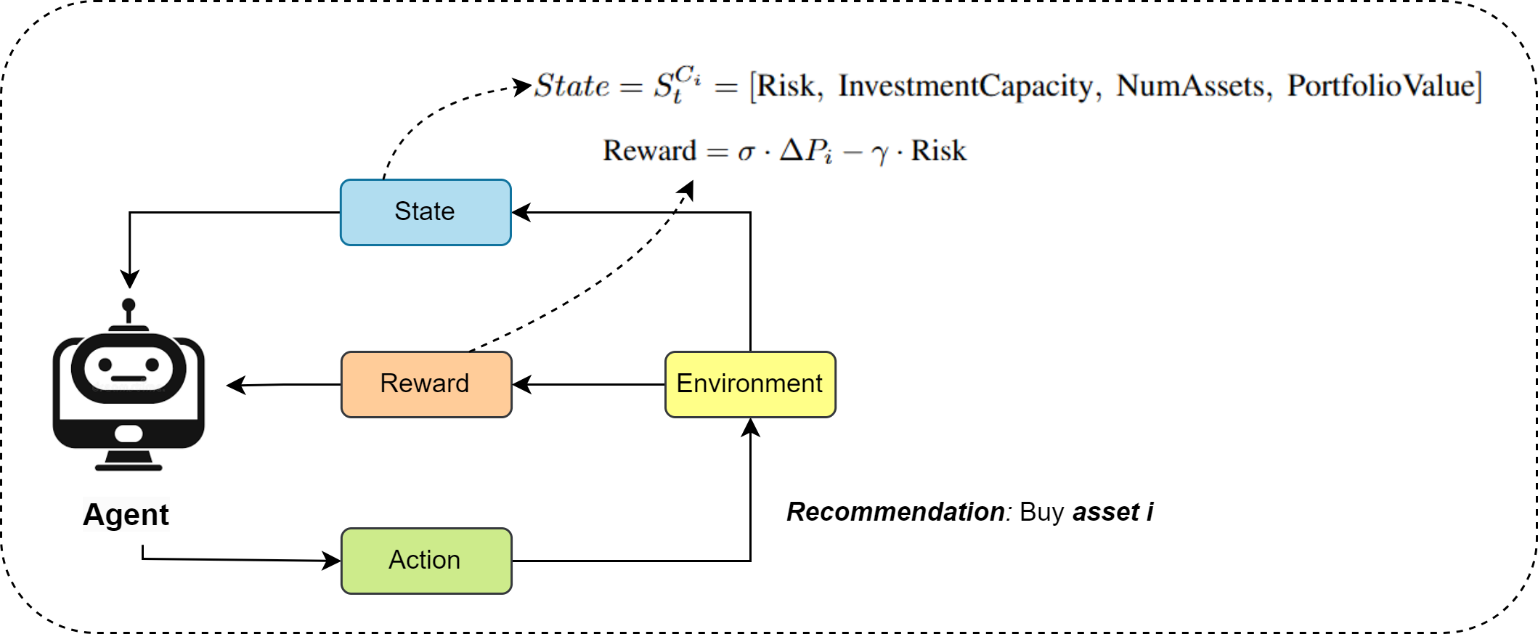
State Representation
17

Slide 18
DQL Implementation and components
18
QNetwork: Neural net for Q-values (state → action values, 256/128 units, ReLU).
ReplayBuffer: Stores (state, action, reward, next_state, done); samples random batches.
DQNAgent:
- Epsilon-greedy action selection.
- Learns via MSE loss, Adam optimizer.
- Uses target network (soft-updated) for stable Q-targets.
- Saves/loads model weights.
Learning Process: Interacts with environment → Stores experience → Samples random batch from Replay Buffer → Calculates target Q-values (using Target Network & Bellman equation → Updates the main Q-Network towards these targets.

Slide 19
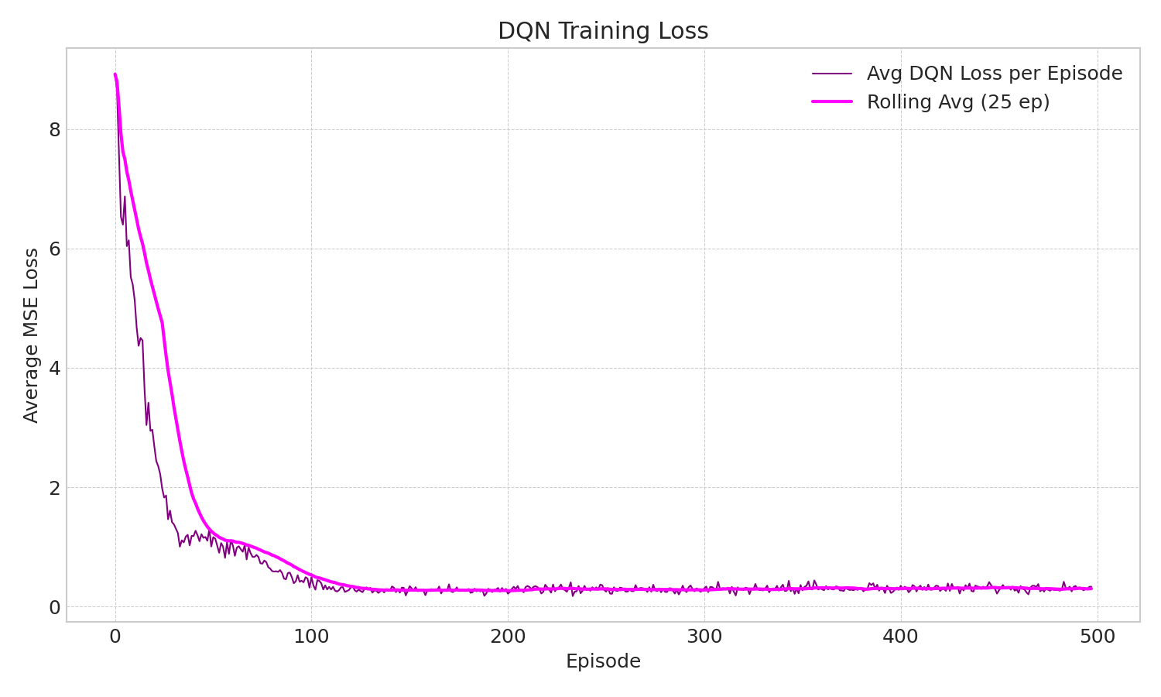
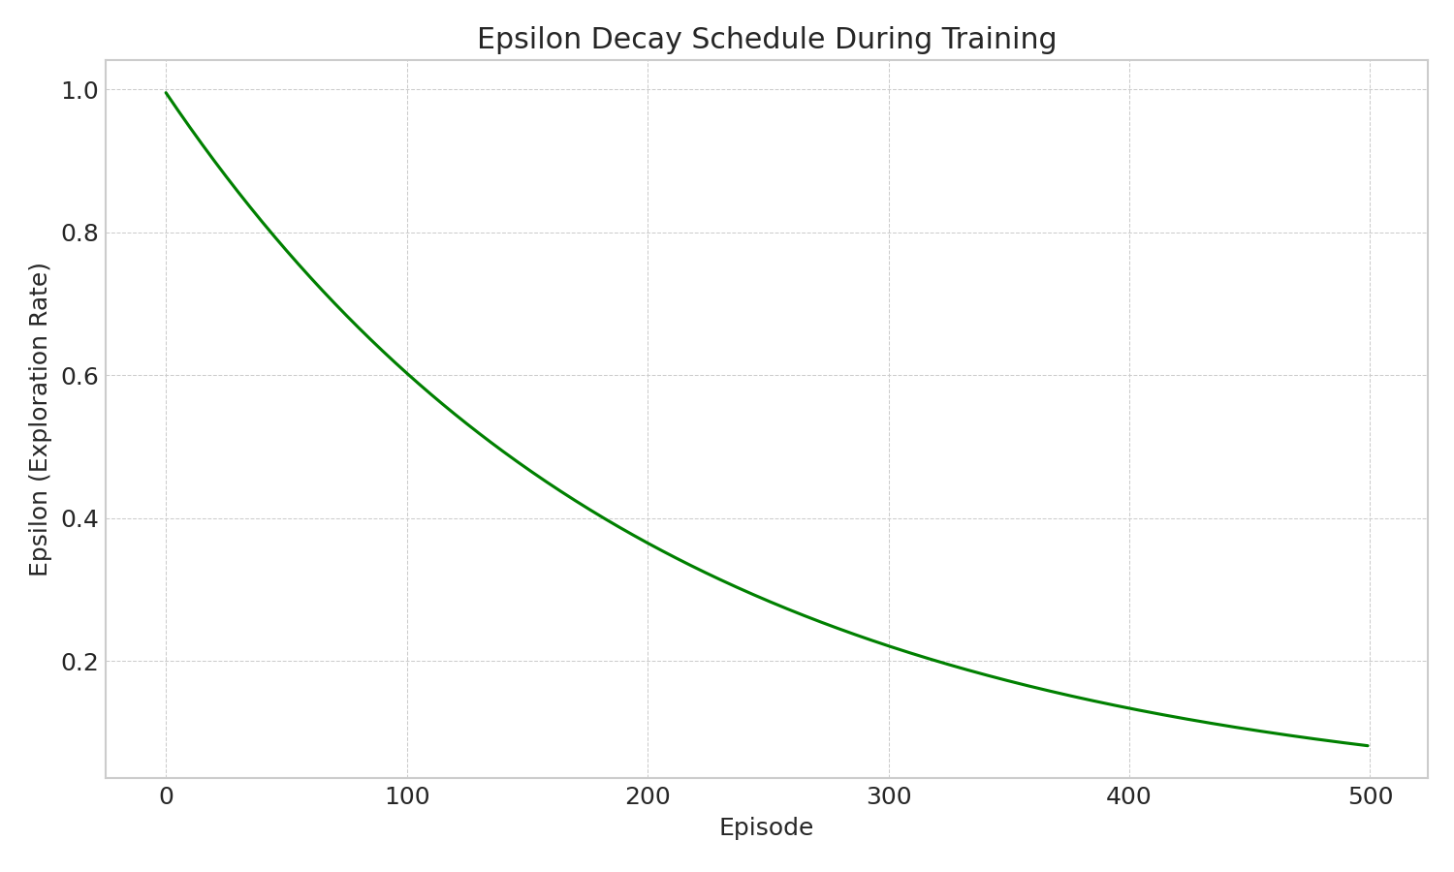
DQL Training
19

Slide 20
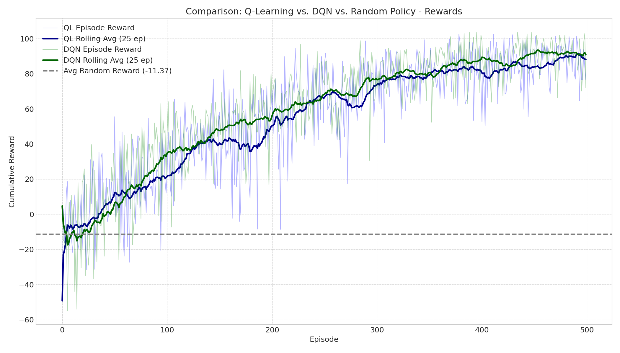
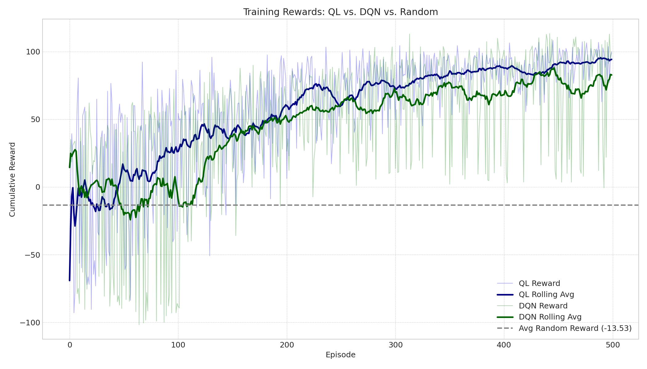
Results and comparison
20
Mock Data
Real Data

Slide 21
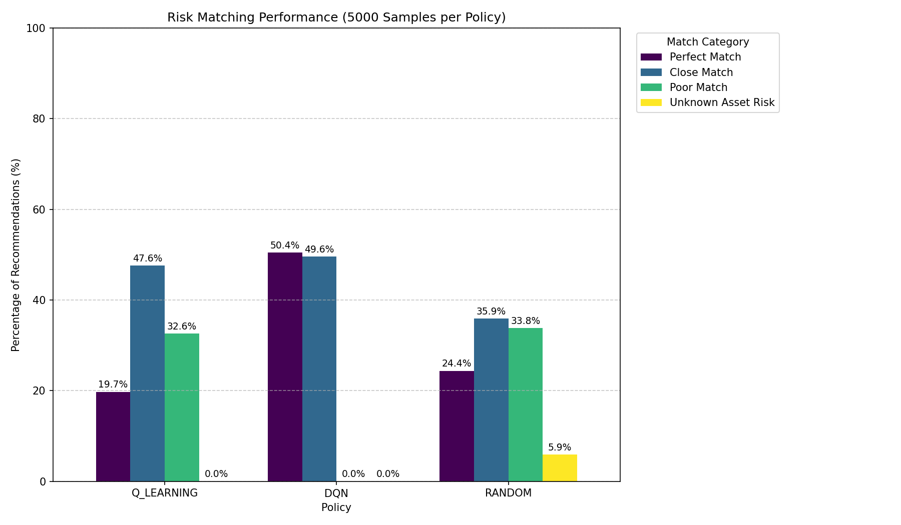
Results and comparison ( Real Data )
21

Slide 22
Limitation of this approach
22
State:
The agent's current observation (state) lacks information about the specific assets and their proportions within the portfolio.
Reward:
The reward mechanism lacks necessary complexity to capture market dynamics and user profile.

Slide 23
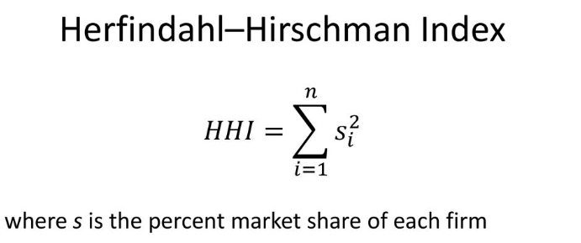
New Reward ( adding a diversification component)

Slide 24
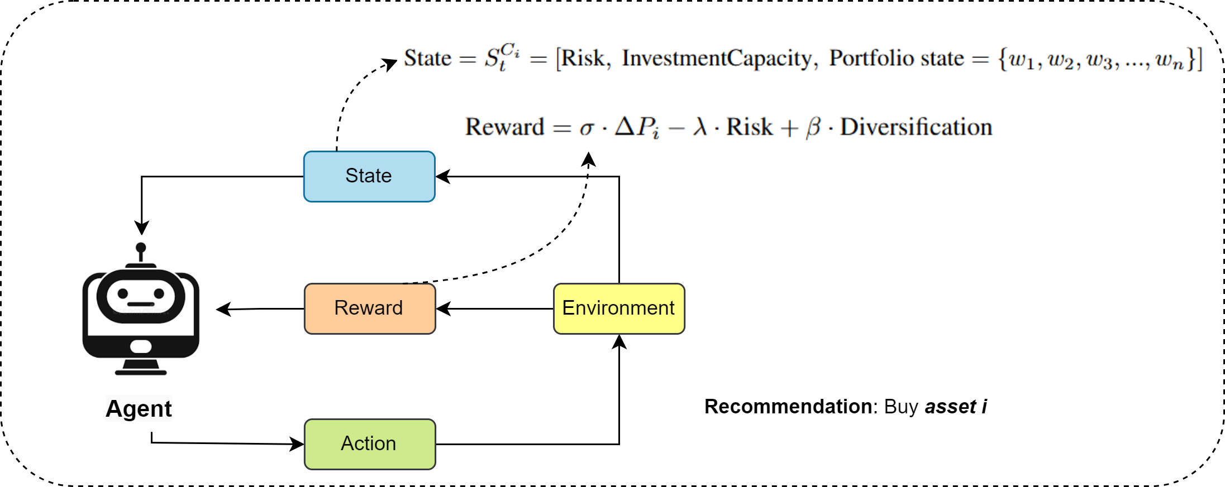
More Rich State Representation
24

Slide 25
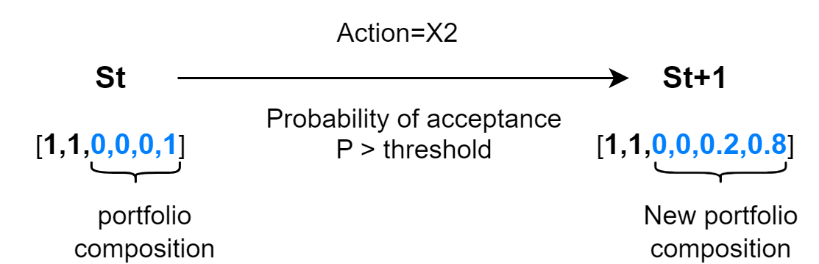
More Rich State Representation
NB: A Q-table cannot be used with a continuous big state representation.

Slide 26
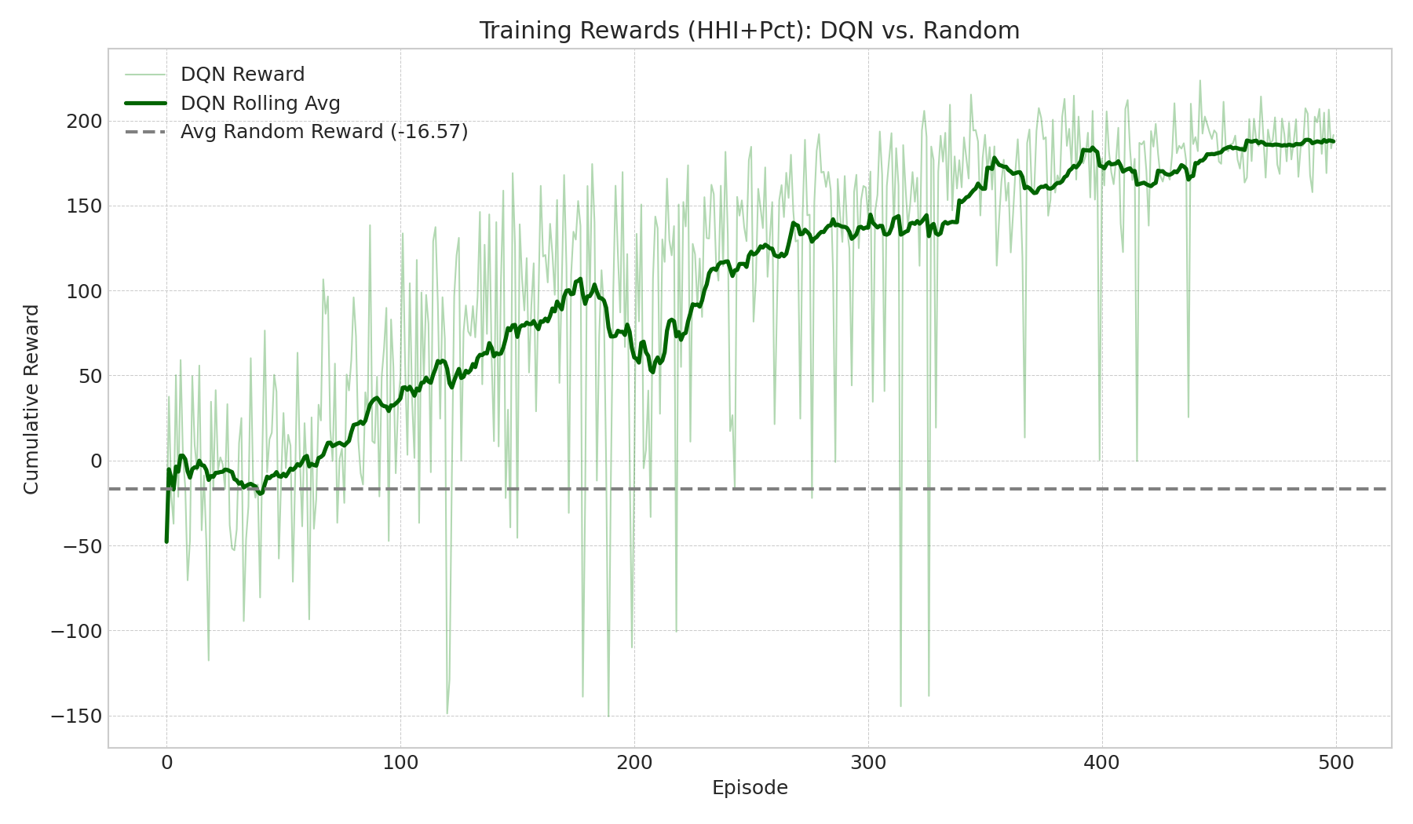
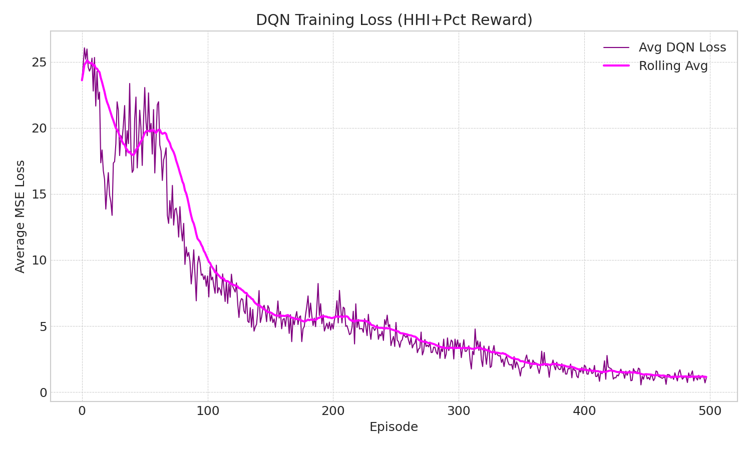
DQL Training and Reward Accumulations

Slide 27
Future Work
Improve State Input: Create dense State Embeddings from the sparse raw state.
Refine Rewards: Integrate Price Forecasts (LSTM/Prophet) for a more predictive reward signal.
Reduce Bias: Adopt Double DQN (DDQN) to mitigate Q-value overestimation.
Strengthen Validation: Implement Sliding Window cross-validation.
Further Hyper-parameters Optimization.
Benchmark Better: Introduce Advanced Heuristic Baselines to replace the random strategy.

Slide 28
This project has received funding from the Horizon Europe research and innovation programme under the Marie Skłodowska-Curie Grant Agreement No. 101119635
This project has received funding from the Horizon Europe research and innovation programme under the Marie Skłodowska-Curie Grant Agreement No. 101119635

Slide 29
Reinforcement Learning based Recommender System for Financial Assets
Mohamed Faid
Ismail Elbouknify

Slide 30
Problem Definition
30
Develop a recommendation system that suggests financial assets tailored to each customer's profile (risk appetite, high/low liquidity etc..) with optimal profitability.
How to recommend financial assets tailored to the customer profile ? .

Slide 31
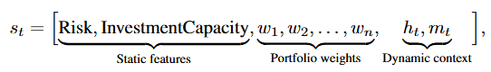
Markov decision process
31
We model the financial asset recommendation task as a Markov Decision Process (MDP) defined by the tuple (S, A, P, R, γ)
State (S): A vector combining static customer information and dynamic transaction data.
Action (A): An action a ∈ A corresponds to recommending a financial asset (or a set of assets) such as stocks, bonds, or mutual funds at time t.
Reward (R): The reward function R(st, at) balances investment performance, risk, and diversification
Objective: The goal is to learn a policy π : S → A that maximizes the expected cumulative discounted reward:

Slide 32
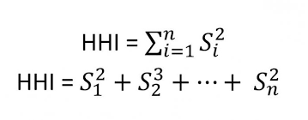
State Representation
32

Slide 33
More Rich State Representation
NB: A Q-table cannot be used with a continuous big state representation.

Slide 34
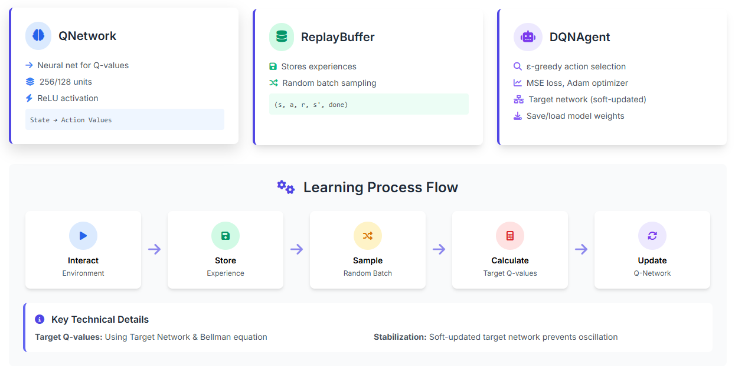
DQL Implementation and components
34

Slide 35
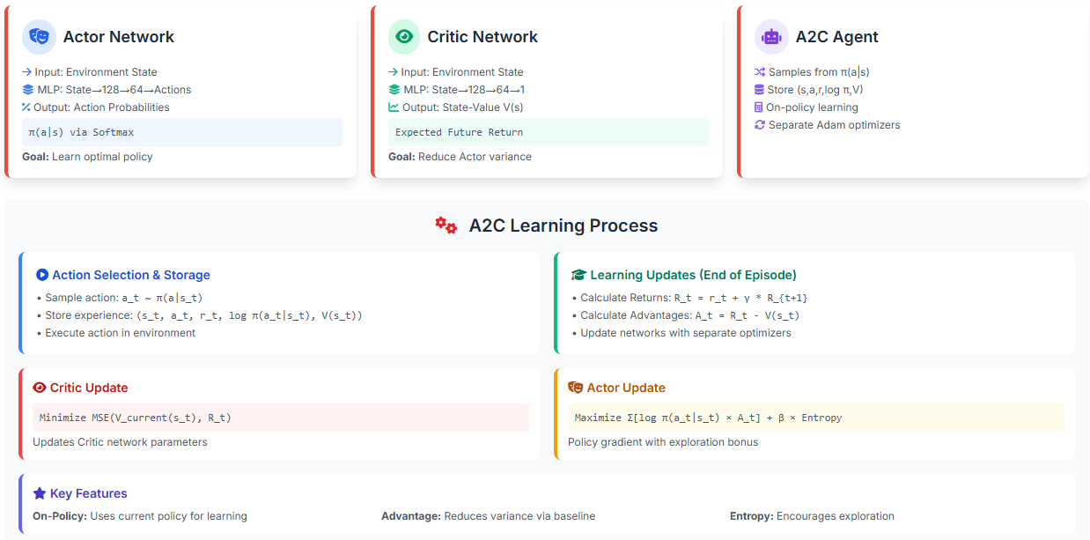
Actor/Critic Implementation and components
35

Slide 36
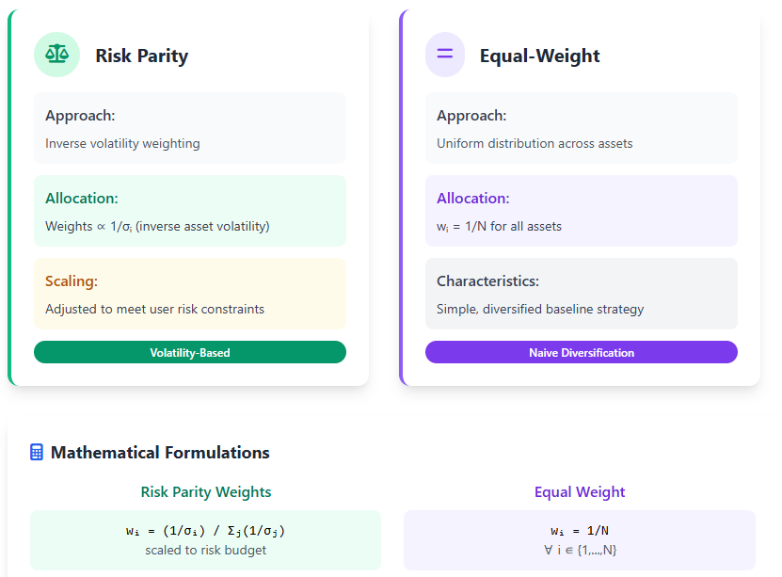
Heuristics
36

Slide 37
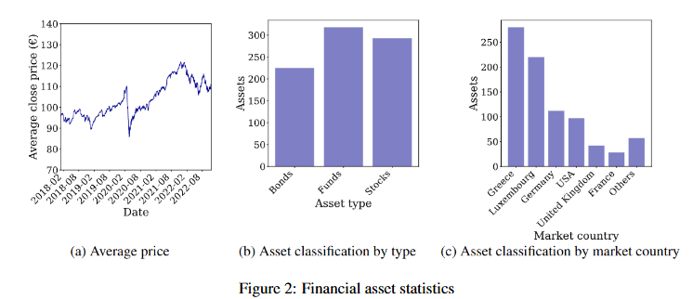
Dataset
37

Slide 38
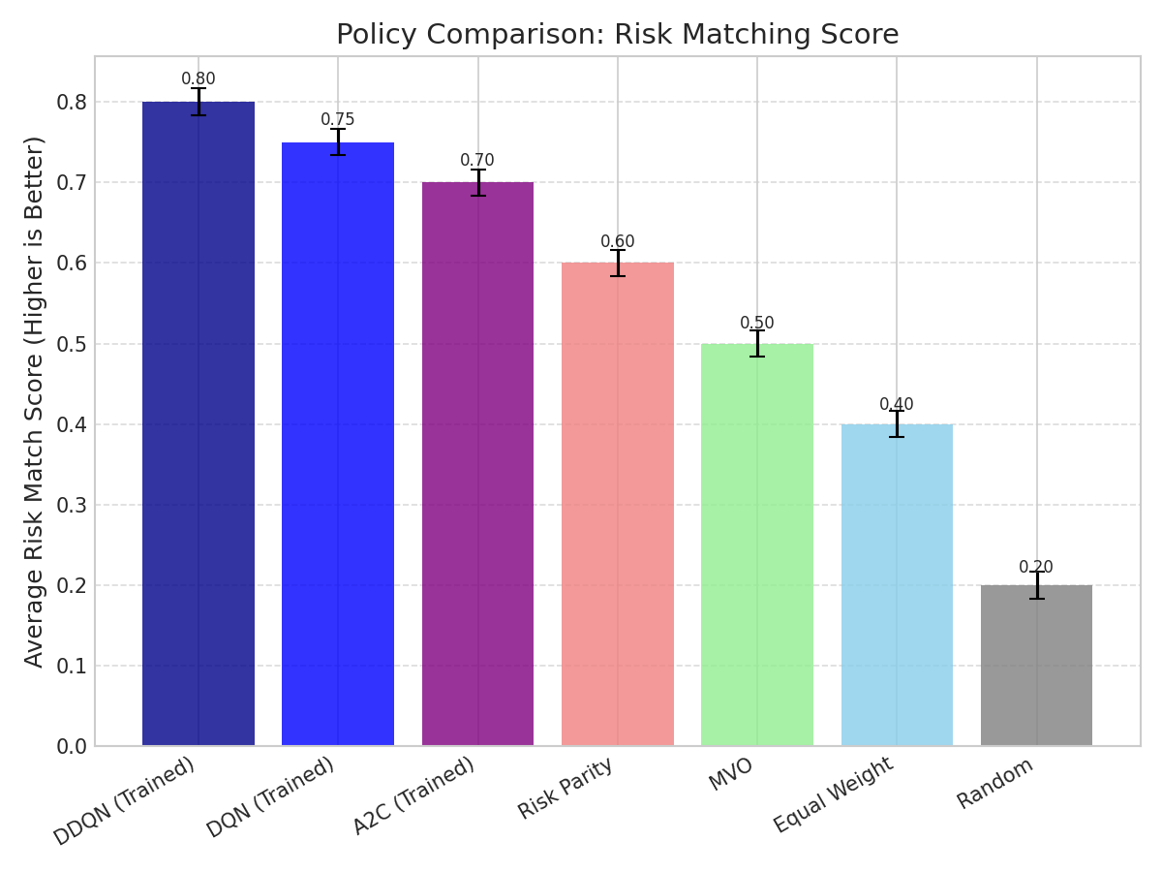
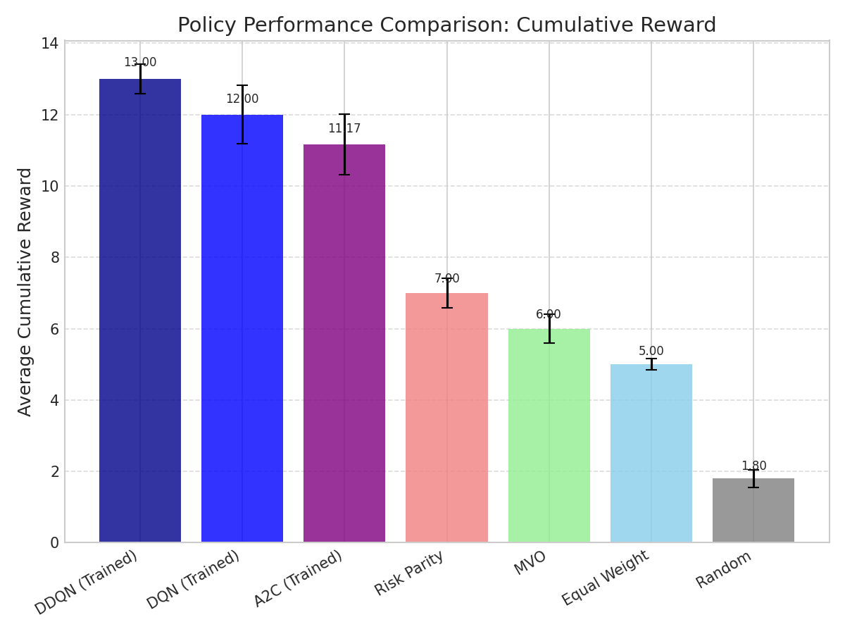
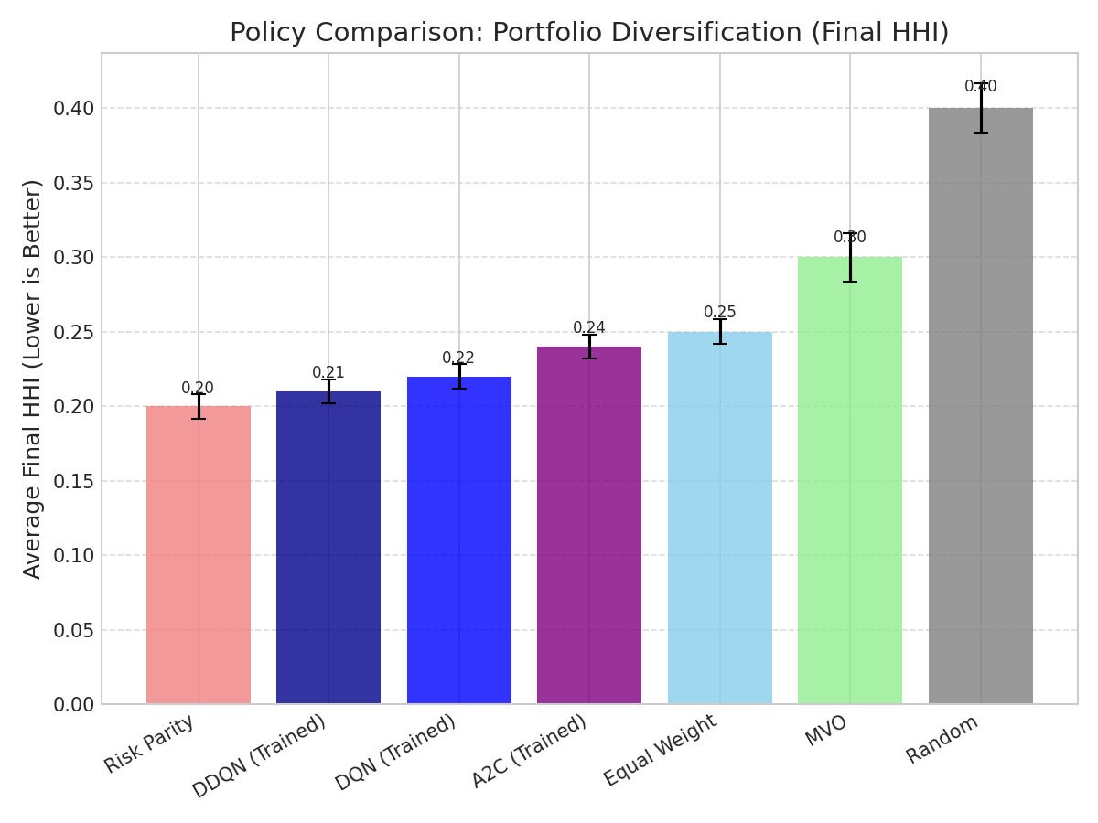
Evaluation ( risk matching, portfolio performance)

Slide 39
Funded by the European Union. Views and opinions expressed are however those of the author(s) only and do not necessarily reflect those of the European Union or Horizon Europe: Marie Skłodowska-Curie Actions. Neither the European Union nor the granting authority can be held responsible for them.
This project has received funding from the European Union’s Horizon Europe research and innovation programme under the Marie Skłodowska-Curie grant agreement No. 101119635

